Slide 1
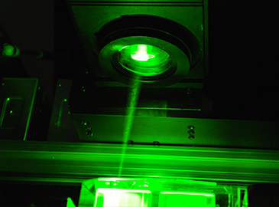
3D Plasma Art
University of Central Florida
Senior Design |Spring 2017
Group 20
Monushka Sicar |Electrical Engineering
Phillip Lane |Electrical Engineering
Burdley Colas |Photonics Science and Engineering
Nicolas Ramirez |Computer Engineering

Slide 2
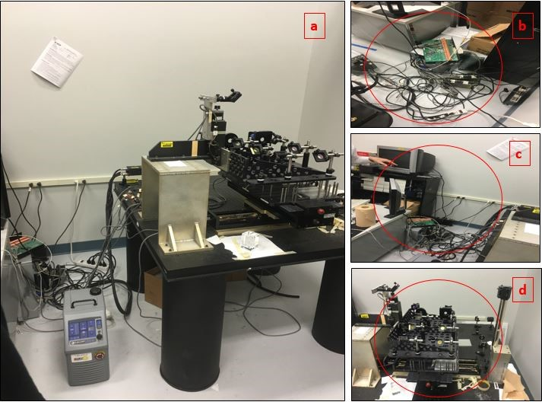
Motivation
Previous System:
- Made for production
- Lacking user friendliness
- Hazardous (Electrical & Optical)
- Long lead time
- Bulky in size
(a) Previous system (b) Electrical components are exposed and dangerous (b) Computer system outdated (c) Optical system to etch six glasses simultaneously, hazardous due to exposed laser beam.

Slide 3
Goals and Objectives
- Construct to have a single glass place holder
- Improvements user friendliness
- Automates image formatting and processing
- Eliminates need for machine pre-orientation
- Laser automatic control
- Automatically activates laser to start dame process
- Turns off laser after process is completed
- Higher safety standards
- Safeguards the PCB and the motor drivers to isolate potential electric shocks.
- Implements a shield around the system to block reflecting laser beam.

Slide 4
Specifications and Requirements
All:
Decrease operating time by 40% (Pegasus logo)
Render different size glass
Min.Glass Size: 2 in x 2 in x 2 in
Max. project machine size: 4 ft x 4 ft x 4 ft
Optical | Laser: 1064 nm PFR 10 Hz Energy 12 mJ | Focusing lens 25.4 mm | Beam Spot Size 16 um diameter | Image Resolution 167 x 167 x 50.1 pixels | Optical Shielding
Electronics | Current source need to be 5.4 Amps | Power supply needs to be 194.4 Watts | Voltage for motors need to be 24-48 Volts per optimal performance | Move 20lbs | Safeguard Electrical components
Computer | Control Laser using RS-232 | Support USB 2.0 (12MB/s) | User friendly interface | Unification of Programs | 2D to 3D Conversion
Notes:
Controls Laser using RS-232 serial communications Start and end of Process
Decreases operating time by 40% based on standard image (Pegasus logo)
Maximum Dimension of rendered art in glass 2 inch x 2 inch x 2 inch (xyz).
Ability to have use different size glass
Must support USB 2.0 Full Speed (12 Mb/s)

Slide 5
Responsibilities
Tasks/Names | Monushka Sicar | Phillip Lane | Nicolas Ramirez | Burdley Colas
Power | First | Second
Movement Mechanisms and Payload | Third | First | Third | Second
Commands and Control | Third | Second | First | Third
Optics |  |  |  | First

Slide 6
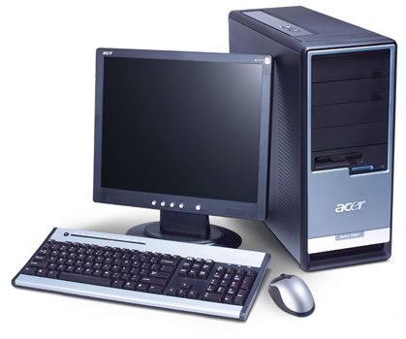
Overall System Diagram
Power
Commands and Control
Movement Mechanisms and Payload
Optics
Monushka Sicar
Phillip Lane
Nicolas Ramirez
Phillip Lane
Burdley Colas
Main Supply
U.S. Standard
(110-120 VAC)
AC/DC Adaptor
(12 VDC)
Regulator
(5VDC)
Microcontroller
Axis Limit Switches
Laser
Motor Driver Supply
(18 - 80 VDC)
Stepper Motor Drivers
USB-to-Serial Chip
Stepper Motors
Optical Assembly
Z-Axis Mount
X and Y Surface Mount
Etching Glass

Slide 7
Power
Power
Commands and Control
Movement Mechanisms and Payload
Optics
Monushka Sicar
Phillip Lane
Nicolas Ramirez
Phillip Lane
Burdley Colas
Main Supply
U.S. Standard
(110-120 VAC)
AC/DC Adaptor
(12 VDC)
Regulator
(5VDC)
Microcontroller
Axis Limit Switches
Laser
Motor Driver Supply
(18 - 80 VDC)
Stepper Motor Drivers
USB-to-Serial Chip
Stepper Motors
Optical Assembly
Z-Axis Mount
X and Y Surface Mount
Etching Glass

Slide 8
Power
- Constraint: using laser source from old machine
- Various operating voltages
- Laser Source: 115 VAC
- Motor Drivers: 18-80 VDC
- MCU: 5 VDC
 | DC Supply (Battery) | AC Supply
Erosion | High: If stayed in for too long can cause erosion | Low: No erosion occurs at power source
Circuit Damage | Low: Since it has power limitations are defined | Medium: Can occur during a power surge (Preventative measures: Surge protector)
Cost | High: Periodic Battery replacement | Low: No need to change Power supply

Slide 9
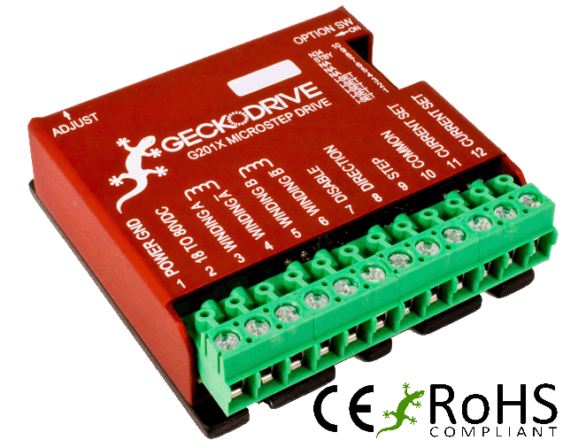
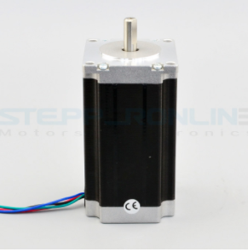
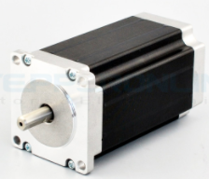
Power Consumption (Runtime)
G201X Digital Step Drive GeckoDrive
- Voltage Rating: 18- 80 VDC
- Power Rating: 1- 13 Watts
Nema 23-Bipolar StepperOnline (340 oz-in)
- Voltage Rating: 24- 48 VDC ( Using 36 VDC)
- Current Rating: 1.8 A/ phase

Slide 10
AC/DC Adapter
All of the electronics comprising the 3-D Laser Etching System, except the laser unit, motors, and motor drivers, are operated on direct current (DC) power
Power needs to converted to DC for the low voltage components ie. (Microcontroller), as well as provide a constant output voltage
Part Number | Input Voltage | Output Voltage | Max Output Current
120-1185 | 120 VAC | 24 VDC | 600mA
120-1165 | 120 VAC | 18 VDC | 600mA
TOL-09442 | 100 - 240 VAC | 12 VDC | 600mA

Slide 11
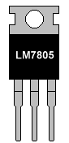
Regulation
Regulator Type
Property | Linear | Switching
Efficiency | Low Vo/Vin | High, > 95%
Noise | Low | High, due to switching
Cost | Low | High
- Supplies 5 VDC to MCU
- Heat sinking a non-issue due to low current consumption
- Efficiency a non-issue due to low current output

Slide 12
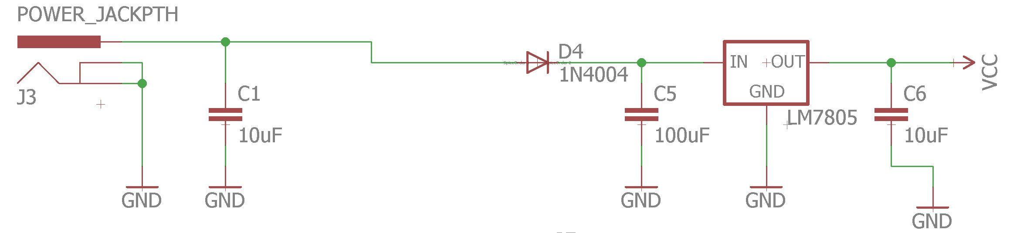
Voltage Regulation

Slide 13
Commands and Control
Power
Commands and Control
Movement Mechanisms and Payload
Optics
Monushka Sicar
Phillip Lane
Nicolas Ramirez
Phillip Lane
Burdley Colas
Main Supply
U.S. Standard
(110-120 VAC)
AC/DC Adaptor
(12 VDC)
Regulator
(5VDC)
Microcontroller
Axis Limit Switches
Laser
Motor Driver Supply
(18 - 80 VDC)
Stepper Motor Drivers
USB-to-Serial Chip
Stepper Motors
Optical Assembly
Z-Axis Mount
X and Y Surface Mount
Etching Glass

Slide 14
Commands and Control
Power
Commands and Control
Movement Mechanisms and Payload
Optics
Monushka Sicar
Phillip Lane
Nicolas Ramirez
Phillip Lane
Burdley Colas
Main Supply
U.S. Standard
(110-120 VAC)
AC/DC Adaptor
(12 VDC)
Regulator
(5VDC)
Microcontroller
Axis Limit Switches
Laser
Motor Driver Supply
(18 - 80 VDC)
Stepper Motor Drivers
USB-to-Serial Chip
Stepper Motors
Optical Assembly
Z-Axis Mount
X and Y Surface Mount
Etching Glass

Slide 15
UART Chip Selection
Selection Criteria
- Pre-programmed
- Support USB 2.0 Full Speed (12 Mb/s)
- 5 V Operation
- Cost
Characteristic | FTDI FT232RL | Microchip PIC18F2550 | Maxim MAX3100
Pre-programmed | Yes | No | No
Support Speed (Mb/s) | 12 | 12 | 12
Operating Voltage (V) | 4 - 5.25 | 2 - 5.5 | 2.7 - 5.5
Cost (USD) | 4.75 | 4.13 | 5.23

Slide 16
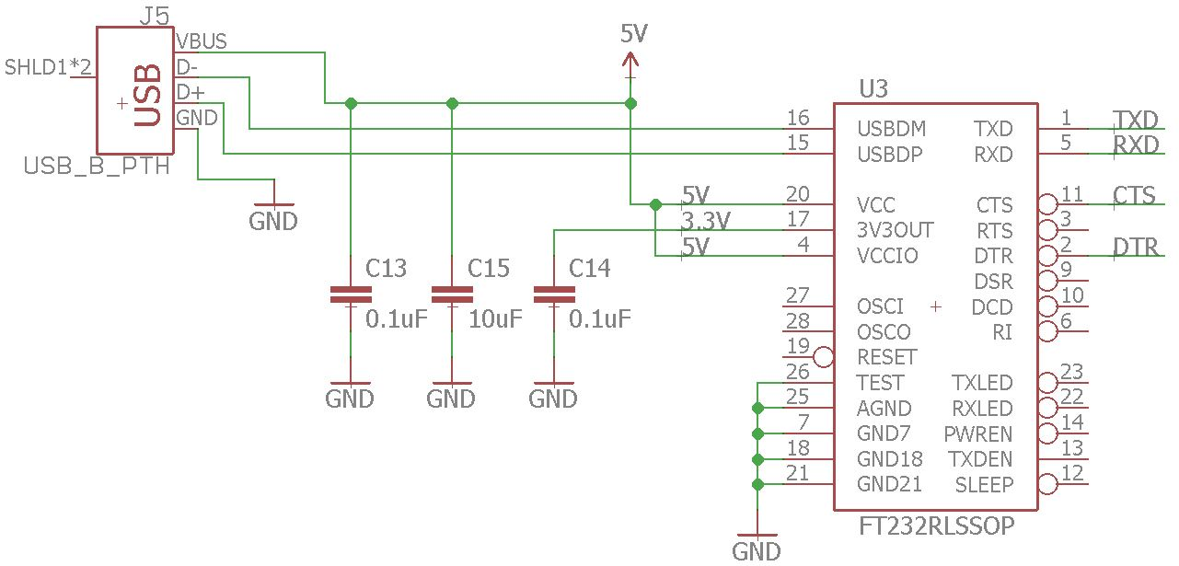
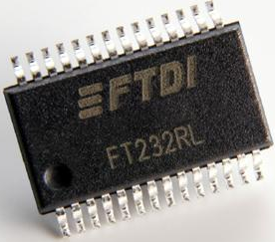
FT232 IC
Purpose
- USB-to-Serial Conversion
- Programming MCU
- Gcode streaming

Slide 17
Commands and Control
Power
Commands and Control
Movement Mechanisms and Payload
Optics
Monushka Sicar
Phillip Lane
Nicolas Ramirez
Phillip Lane
Burdley Colas
Main Supply
U.S. Standard
(110-120 VAC)
AC/DC Adaptor
(12 VDC)
Regulator
(5VDC)
Microcontroller
Axis Limit Switches
Laser
Motor Driver Supply
(18 - 80 VDC)
Stepper Motor Drivers
USB-to-Serial Chip
Stepper Motors
Optical Assembly
Z-Axis Mount
X and Y Surface Mount
Etching Glass

Slide 18
MCU Selection
Characteristic | Atmel ATmega 328P | Atmel ATmega 32U4 | Atmel ATmega 2560
Operating Voltage | 1.8 - 5.5 V | 2.7 - 5.5 V | 1.8 - 5.5 V
Serial Port (UART) | Yes, one port | Yes, one port | Yes, four ports
Flash Memory | 32 KB | 32 KB | 256 KB
Max I/O pins | 14 (6 PWM) | 20 (7 PWM) | 54 (15 PWM)
Max Frequency (at 5 V) | 20 MHz | 16 MHz | 16 MHz
Current (max frequency) | ~ 12 mA | ~ 13 mA | ~ 20 mA
Cost / Form | $4.30 / TH | $6.95 / SMD | $4.95 / SM)
Selection Criteria
- UART communication
- ≥ 9 Digital I/O Pins (3 PWM)
- Cost/Component Form
- Current consumption
- Speed
- 5 V Operation

Slide 19
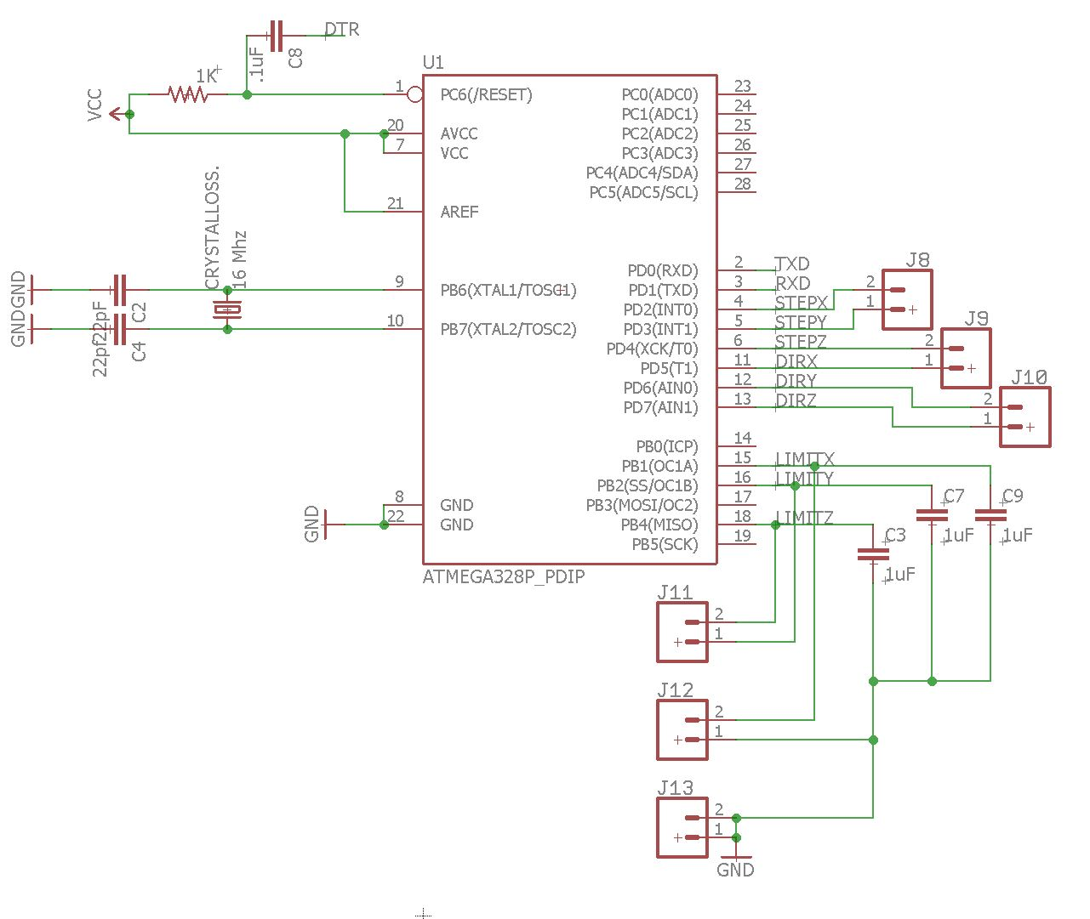
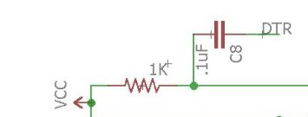
MCU Schematic

Slide 20
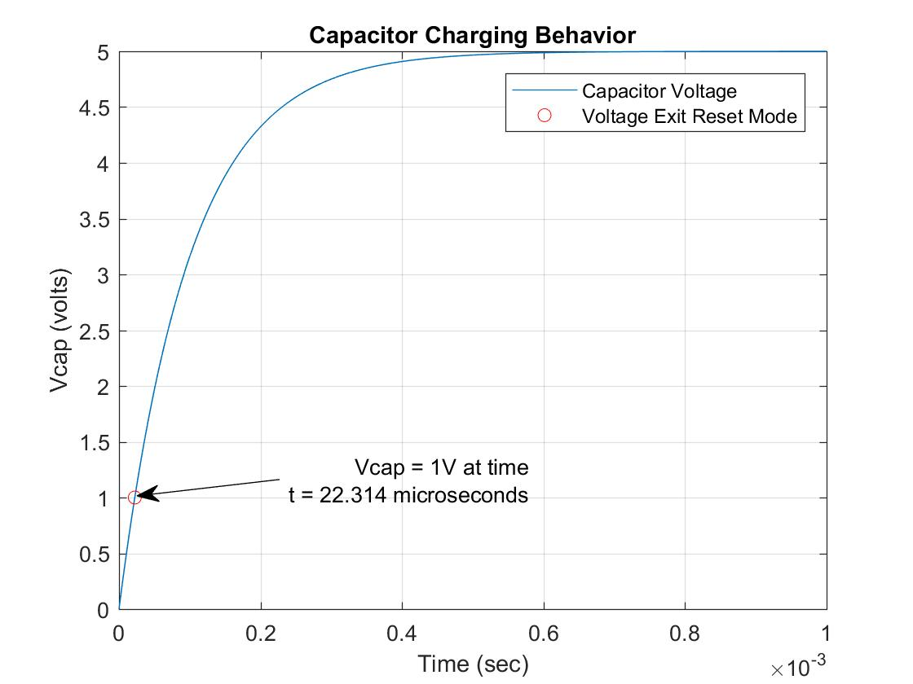
MCU Communication

Slide 21
MCU Firmware

Slide 22


MCU Firmware
Critical System Needs
- Concurrent control of 3 stepper motors
- Acceleration management
- Lines
- Corners
Arcs
- Automatic Homing
- Look Ahead Planning
- Storage of travel settings
- Steps/millimeter
- Max Speed and Acceleration
Teacup

Slide 23
Firmware Options
Feature | Firmware
 | GRBL | Marlin | Teacup
Homing | Yes | Yes | Yes
Acceleration Management | Yes | Yes | Yes
Concurrent Motor Control | Yes, 3 motors | Yes, 3 motors | Yes, 4 motors
Look Ahead Planning | Yes | Yes | Yes
Travel Settings Storage | Yes | Yes | Yes, optional

Slide 24
Grbl High Level Diagram
Start
Homing
Buffer Full?
NO
YES
Wait for Command to Clear
Read Command
Parse Command
Command Cleared
Accept Command
Velocity & Acceleration Planner
GCode Buffer
Execute Command
Clear Command

Slide 25
Commands and Control
Power
Commands and Control
Movement Mechanisms and Payload
Optics
Monushka Sicar
Phillip Lane
Nicolas Ramirez
Phillip Lane
Burdley Colas
Main Supply
U.S. Standard
(110-120 VAC)
AC/DC Adaptor
(12 VDC)
Regulator
(5VDC)
Microcontroller
Axis Limit Switches
Laser
Motor Driver Supply
(18 - 80 VDC)
Stepper Motor Drivers
USB-to-Serial Chip
Stepper Motors
Optical Assembly
Z-Axis Mount
X and Y Surface Mount
Etching Glass

Slide 26
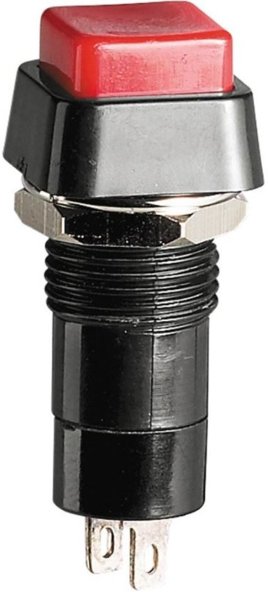
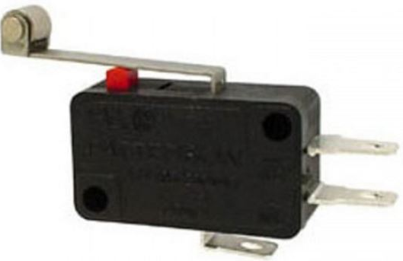
Axis Limit Switches
Velleman’s Lever Switch
Radioshack’s Push Button Switch
- NO or NC
- Two holes for mounting
- Lever best pushed by inclined contacts
- NO only
- Can insert in 1/4” holes
- Pushed by direct linear contact/force

Slide 27
Overall Schematic
Regulated 5 V
MCU Power
Data Streaming via UART
GCODE Interpretation and Motor Control

Slide 28
Commands and Control
Power
Commands and Control
Movement Mechanisms and Payload
Optics
Monushka Sicar
Phillip Lane
Nicolas Ramirez
Phillip Lane
Burdley Colas
Main Supply
U.S. Standard
(110-120 VAC)
AC/DC Adaptor
(12 VDC)
Regulator
(5VDC)
Microcontroller
Axis Limit Switches
Laser
Motor Driver Supply
(18 - 80 VDC)
Stepper Motor Drivers
USB-to-Serial Chip
Stepper Motors
Optical Assembly
Z-Axis Mount
X and Y Surface Mount
Etching Glass

Slide 29

Software Design
Programming Language
Python
- Python vs Java
- Time Efficiency
- Extensive Standard Library
Libraries
- TkInter
- pySerial
- Pillow
Operating System
- Windows 10

Slide 30
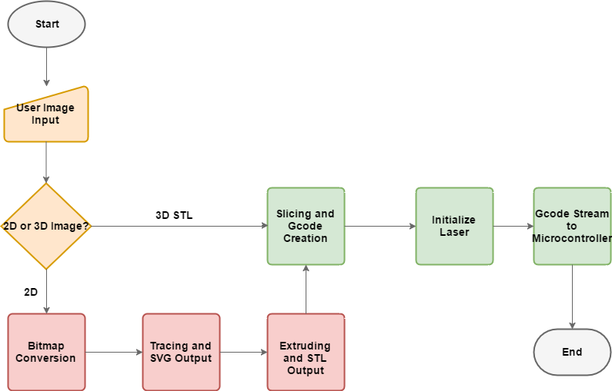
Simplified Flow
User Input
2D - 3D Conversion
Etching

Slide 31
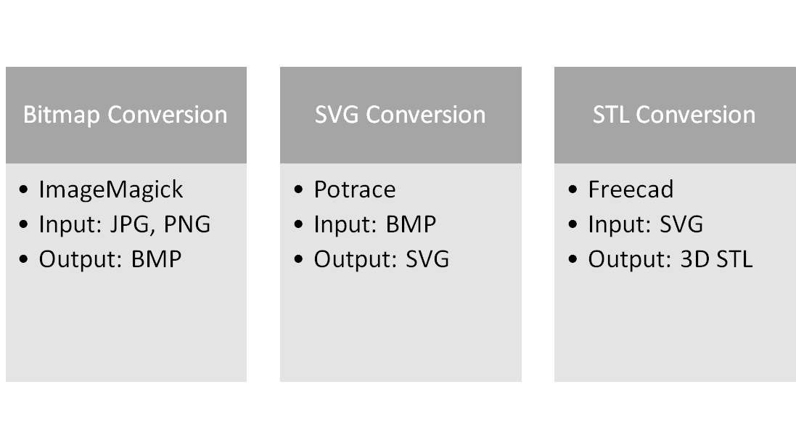
2D to 3D Conversion

Slide 32

Example Conversion
JPG/PNG File BMP SVG STL

Slide 33
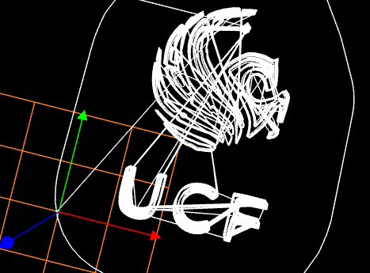
Gcode Creation
G-code
- Numerical Control Language
- Standard in CAM tools and machines
- Movements
- Where to, how fast, what path
Slicing
- Slic3r
- 3D object is “cut” into horizontal slices
- Each slice is converted into Gcode
- Layered Toolpaths
Example G-code

Slide 34

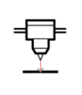

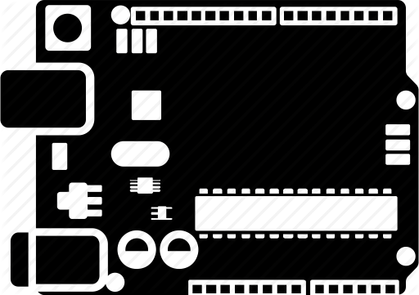
Gcode Streaming
Python Script
- Pyserial module
- Python Standard Library
RS-232 Interface
- Serial communications interface
- Laser control before and after streaming
USB
- Microcontroller communications
- Gcode transmission

Slide 35


User Interface
TkInter Module
- Python Standard Library
- Layer over Tcl/Tk Toolkit
- Object Oriented
Major Focuses of UI
- Automation
- Simplicity
- Unification

Slide 36
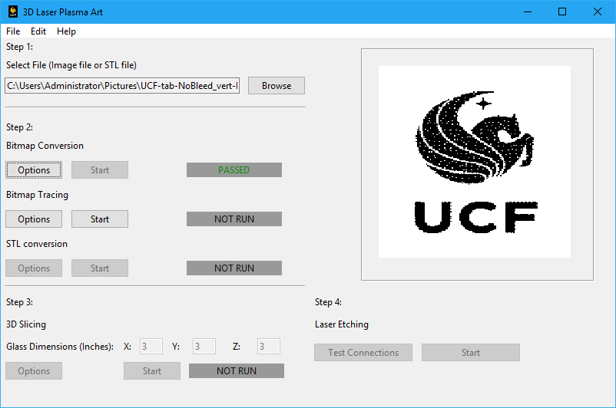
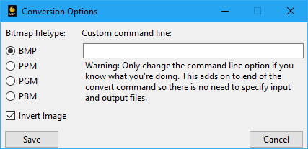
User Interface Design

Slide 37
Optics
Power
Commands and Control
Movement Mechanisms and Payload
Optics
Monushka Sicar
Phillip Lane
Nicolas Ramirez
Phillip Lane
Burdley Colas
Main Supply
U.S. Standard
(110-120 VAC)
AC/DC Adaptor
(12 VDC)
Regulator
(5VDC)
Microcontroller
Axis Limit Switches
Laser
Motor Driver Supply
(18 - 80 VDC)
Stepper Motor Drivers
USB-to-Serial Chip
Stepper Motors
Optical Assembly
Z-Axis Mount
X and Y Surface Mount
Etching Glass

Slide 38
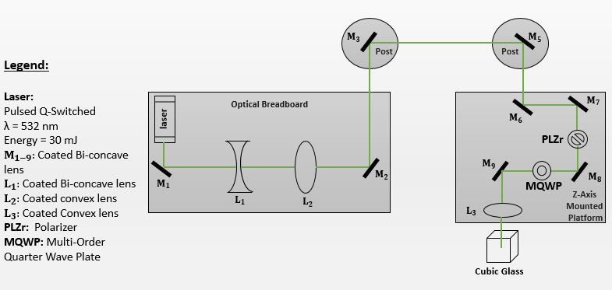
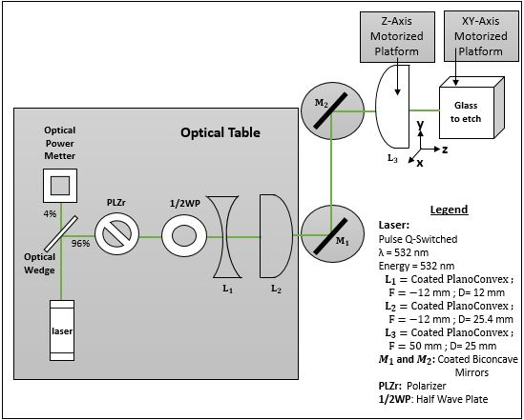
Optical System Design
1
2
Changes in Design to meet Customer needs:
- These two previous designs were replaced to have the beam propagates on a straight axis.
- Change in axis of propagation leads to optical power loss and polarization change.
- Change of the optical design yields to smaller size system.
- Optical elements on these designs are for the wavelength 532 nm.

Slide 39
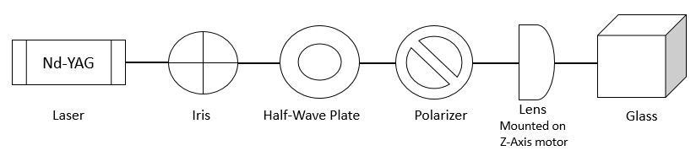
Optical System Design
Legend:
- Optical system is assembled along the Z-Axis
- Iris serves as an aperture in front of the laser
- Polarizer and Half Wave Plate serves as an analyzer controlling the laser beam energy before damaging the glass
- Focusing lens is a plano convex lens

Slide 40
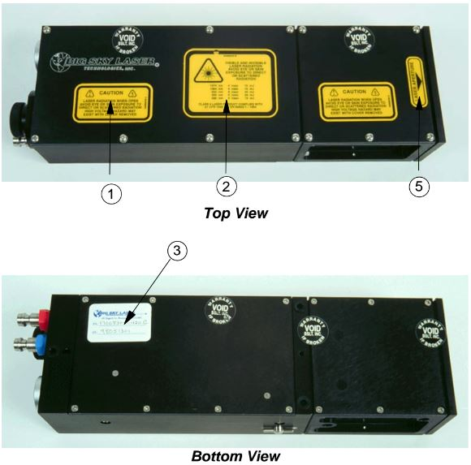
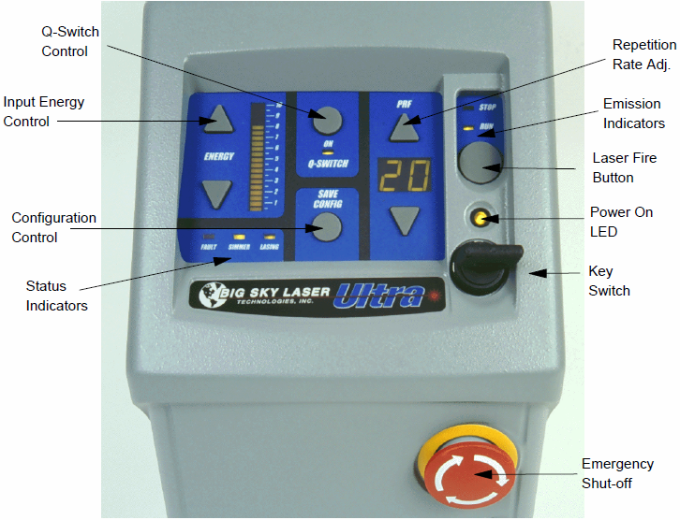
Laser:
- Type: Nd-YAG
- Operating Wavelength: 1064 nm
- Energy: 10 mJ
- PRF: 5 Hz
- Pulse Width: 10 ns
- Q-Switched
- Pulsed
- Water Cooled
- Flashlamp Pumped
Laser Operation:
Turn Key
Adjust Desired Energy level
Adjust Repetition Rate Frequency
Push Q-Switch
FIRE/STOP (control through RS-232)
Credit: Big Sky Laser Manual

Slide 41
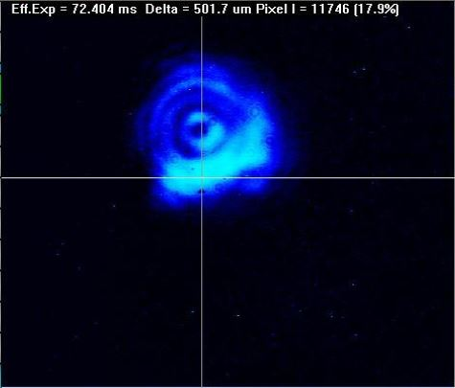
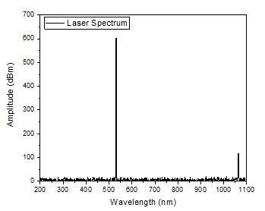
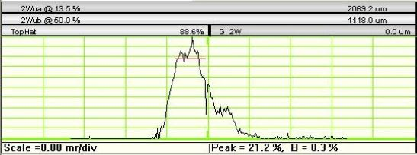
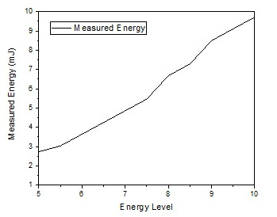
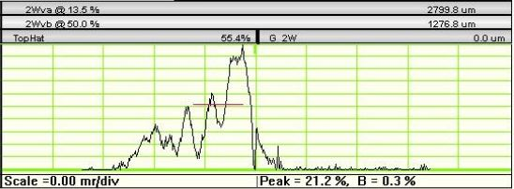
Laser
Parameters:
- Laser was not able to operate at 532 nm due to fault of the nonlinear crystal.
- Laser stability is questionable. Beam Profile is not an evenly distributed.
Laser Beam wonders due to the nonlinear crystal.
Note: Calibration of laser would yield to accurate measurements yielding to better image resolution.
Laser spectrum
Energy Level vs Output Energy Measured

Slide 42
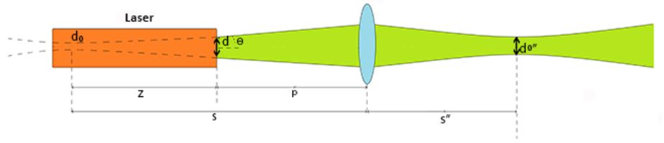
Focusing Lens
Determining the Focal Spot size of the Laser Beam at the Glass:
𝛌 = 1064 nm d = (2w) = 1.3 mm s = 1054.792 mm
Fl = 25.4 mm p = 500 mm s”= 25.996 mm
M² = 1 d₀= (2w₀) = 0.677 mm d₀” = 0.016 mm
𝛳 = 1 mRad z = 554.792 mm z_{r}” = 0.186 mm
Credit: http://www.ophiropt.com/laser-measurement-instruments/laser-power-energy-meters/services/focal-spot-size-calculator-for-gaussian-beams

Slide 43

Image Resolution:
- Our Image to etch is the
UCF Pegasus Logo
- Dimension
1 inch x 1 inch x 0.3 inch
- Resolution
167 x 167 x 50.1 pixels
- Beam spot size
16 um diameter
- Thickness Layer Spacing
1 mm

Slide 44
Administrative Content

Slide 45
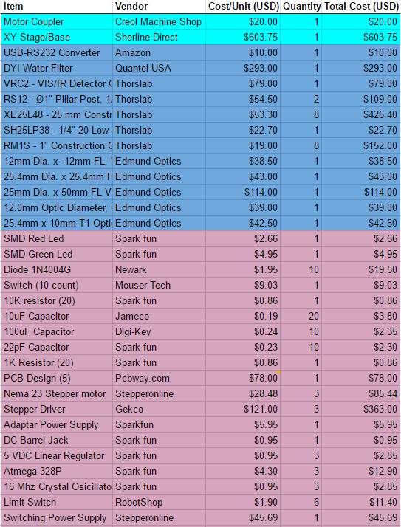
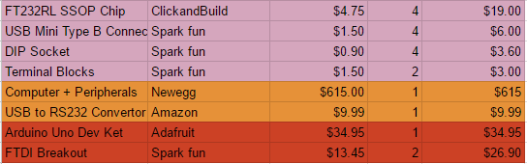
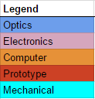
Project Budget
Notes:
Monushka : Burdley & Nick, can you insert your last purchase on the Overall project budget
All: Once burdley & nick insert theirs , I will add it to this slide

Slide 46
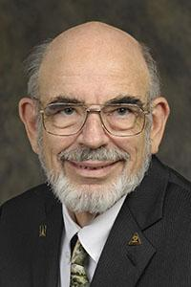
Acknowledgement
This project is sponsored by Dr. M.J. Soileau from The College of Optics and Photonics, CREOL.

Slide 47
Questions?

